Slide 1
'No known antidote': Paraquat and its domestic users in Britain
Cat Rushmore
Oxford Brookes University
Science Museum

Slide 2
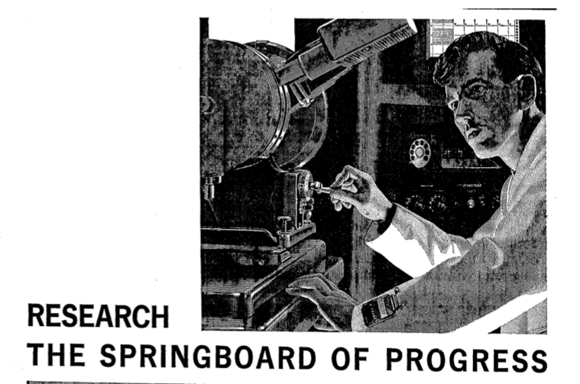
ICI, display ad, The Times, p.9, 01 July 1963

Slide 3
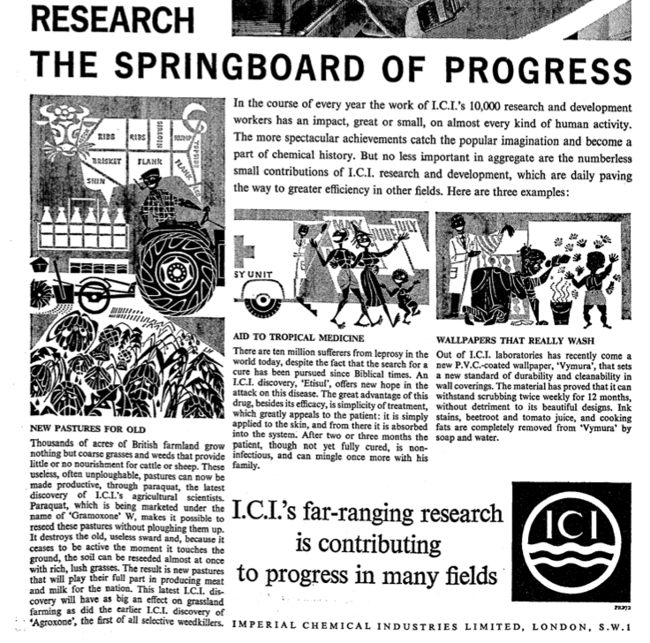
ICI, display ad, The Times, p.9, 01 July 1963

Slide 4
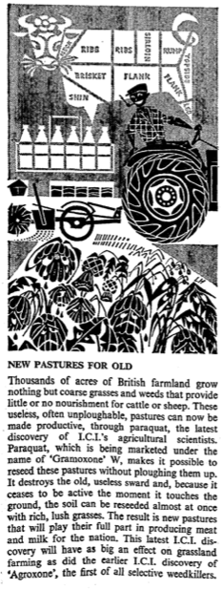
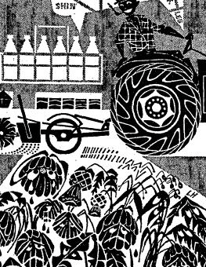
ICI, display ad, The Times, p.9, 01 July 1963

Slide 5
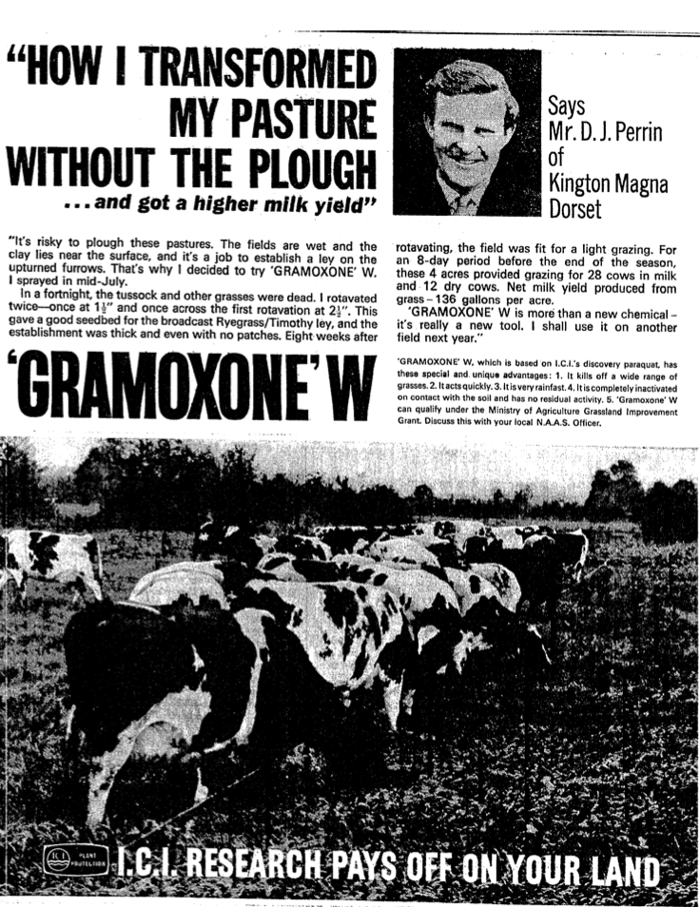
ICI , display ad,
The Times,
p. ii, 07 Dec. 1964

Slide 6
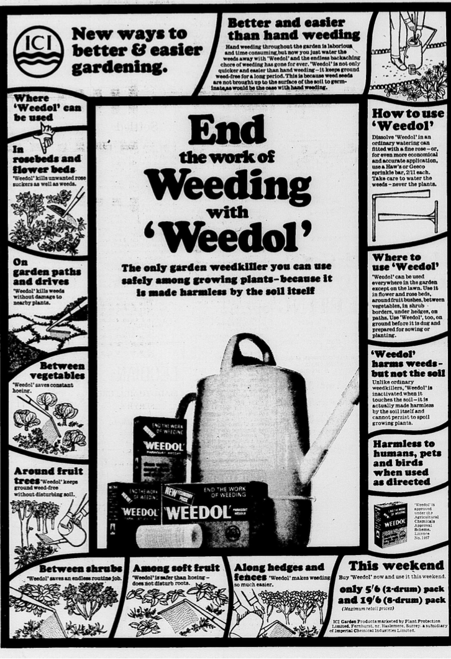
1966
display ad,
Daily Mail
April

Slide 7
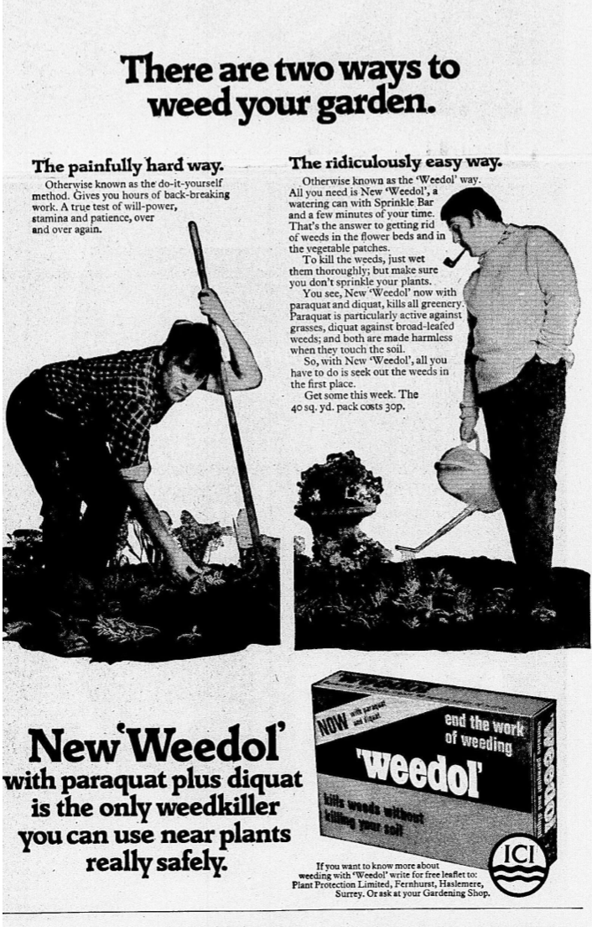
1971
Display ad,
The Daily Mail
April

Slide 8
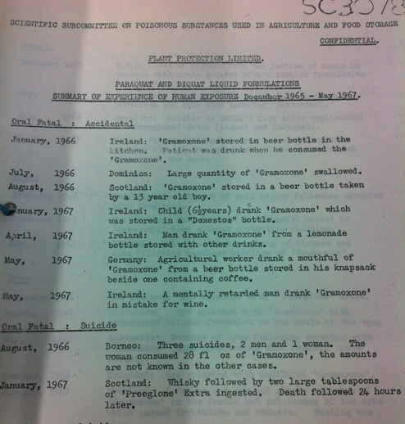
HO305/32
National Archives,
Kew

Slide 9
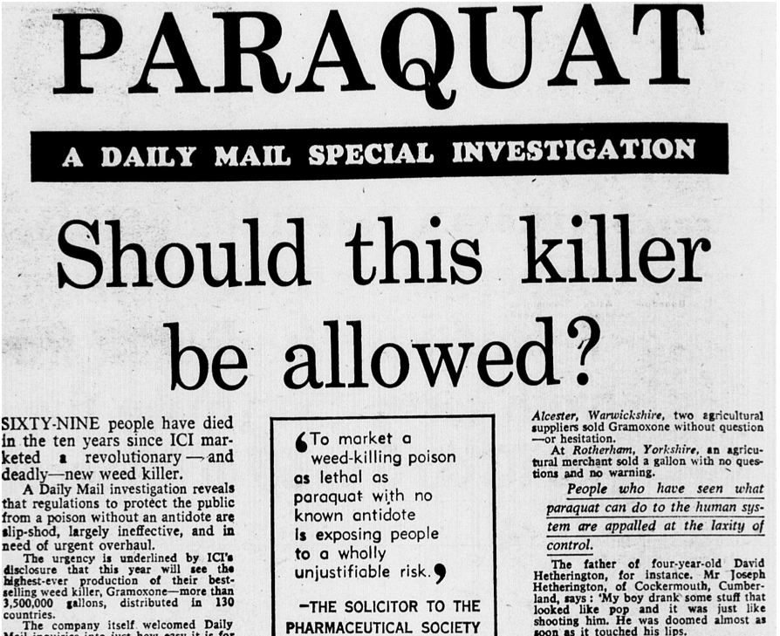
Daily Mail
30 Aug.
1972
p.6

